Slide 1
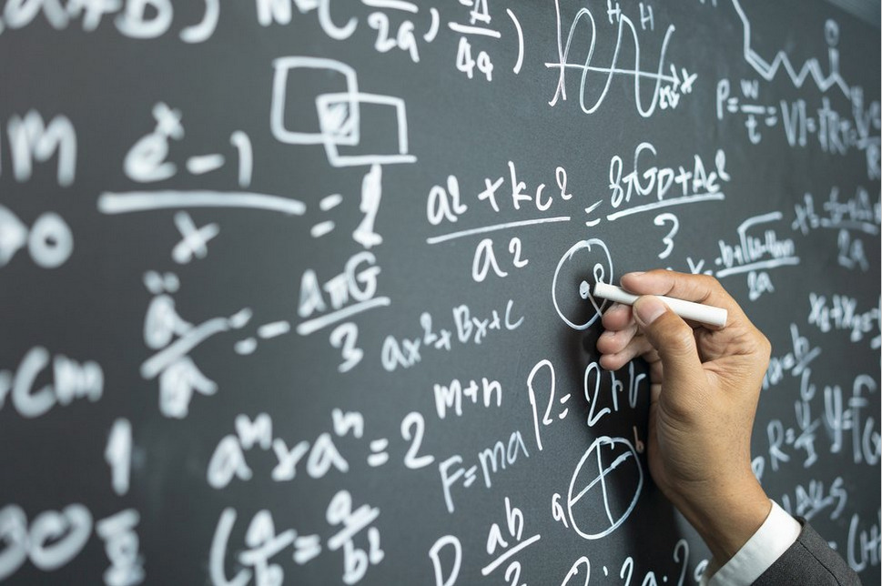
Week # 4
Operations Research
(Software Engineering)

Slide 2
Simplex Method
The simplex, an important term in mathematics, represents an object in an n-dimensional space,connecting n + 1 points. In one dimension, the simplex represents a line segment connecting two points; in two dimensions, it represents a triangle formed by joining three points; in three dimensions, it represents a four-sided pyramid.
Example 1:
A company manufactures two products A and B. Both products are processed on two machines M1 and M2.
Profit per unit of A is Rs=100 and for B is Rs=80. Find out the monthly production of A and B to maximize profit.
Products | M1 | M2
A | 6 hrs/Unit | 2 hrs/Unit
B | 4 hrs/Unit | 4 hrs/Unit
Availability | 7200 hrs/month | 4000 hrs/month

Slide 3
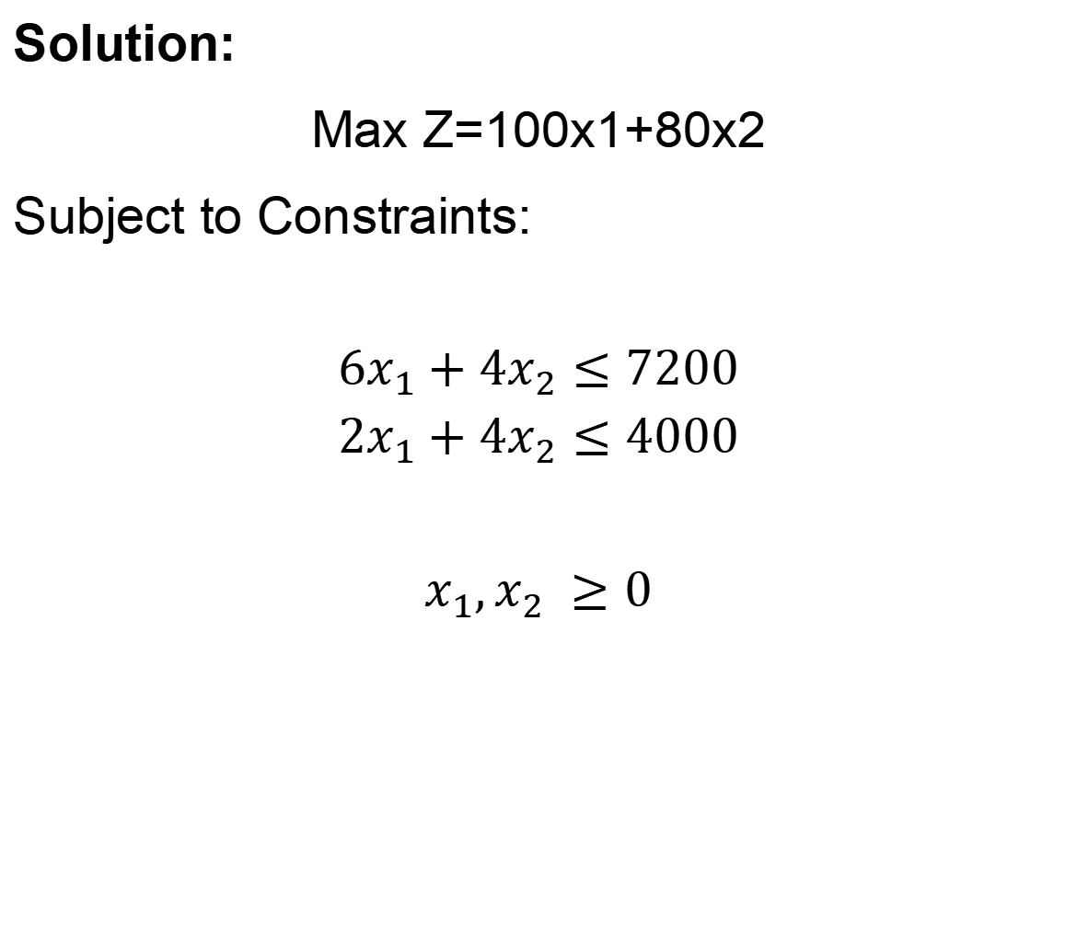
Simplex Method
Solution:
Max Z=100x1+80x2
Subject to Constraints:
$$6x_{1}+4x_{2}≤7200$$
$$2x_{1}+4x_{2}≤4000$$
$$x_{1},x_{2} ≥0$$

Slide 4
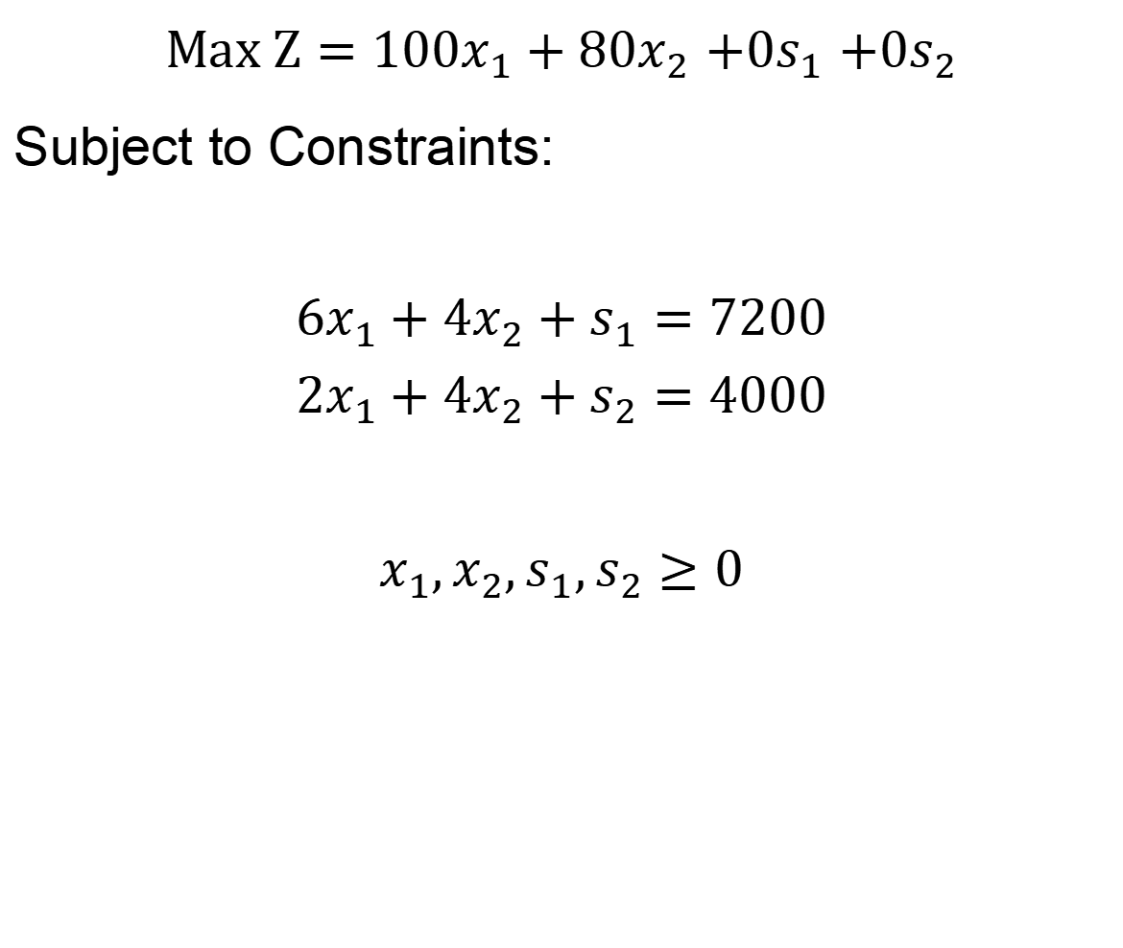
Simplex Method
$Max Z=100x_{1}+80x_{2}$ $+0s_{1}$ $+0s_{2}$
Subject to Constraints:
$$6x_{1}+4x_{2}+s_{1}=7200$$
$$2x_{1}+4x_{2}+s_{2}=4000$$
$$x_{1},x_{2},s_{1},s_{2}≥0$$

Slide 5
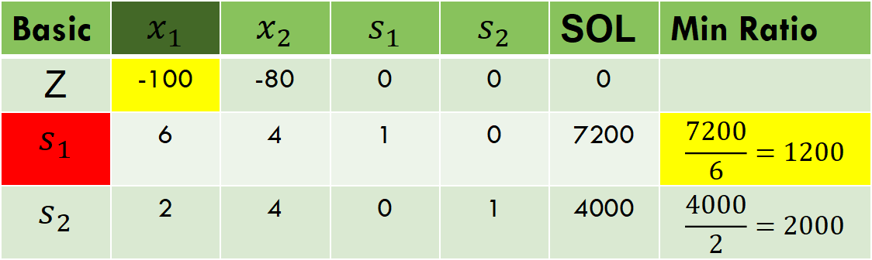

Simplex Method
$Z−100x_{1}−80x_{2}$ $−$ $0s_{1}−0s_{2}=0$
Key column
key row
Basic | $$x_{1}$$ | $$x_{2}$$ | $$s_{1}$$ | $$s_{2}$$ | SOL | Min Ratio
Z | -100 | -80 | 0 | 0 | 0
$$s_{1}$$ | 6 | 4 | 1 | 0 | 7200 | $$\frac{7200}{6}=1200$$
$$s_{2}$$ | 2 | 4 | 0 | 1 | 4000 | $$\frac{4000}{2}=2000$$

Slide 6
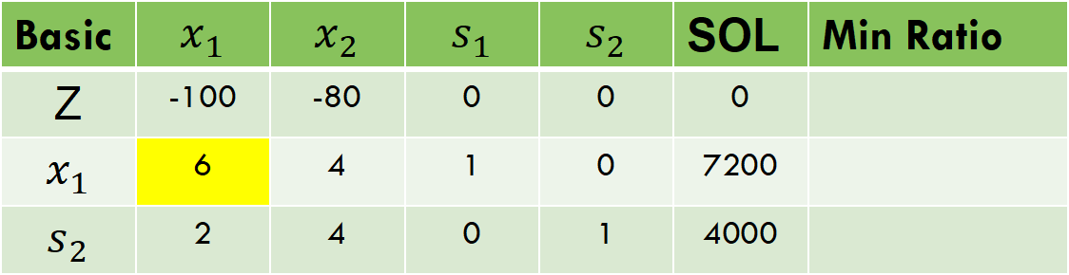
Simplex Method
Entering variable = Less negative value in z-row
Leaving variable= Minimum ratio value
Basic | $$x_{1}$$ | $$x_{2}$$ | $$s_{1}$$ | $$s_{2}$$ | SOL | Min Ratio
Z | -100 | -80 | 0 | 0 | 0
$$x_{1}$$ | 6 | 4 | 1 | 0 | 7200
$$s_{2}$$ | 2 | 4 | 0 | 1 | 4000

Slide 7
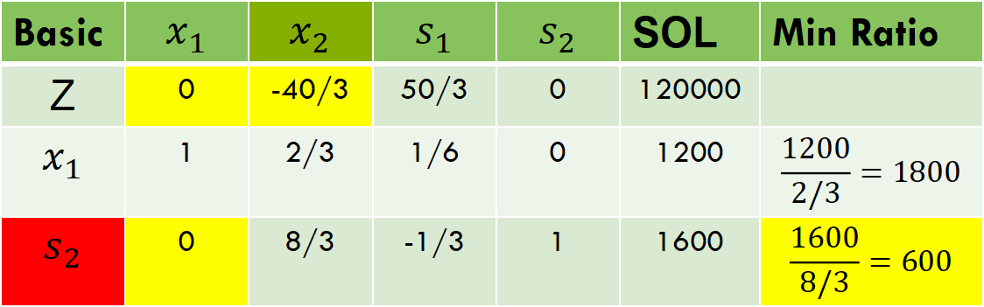

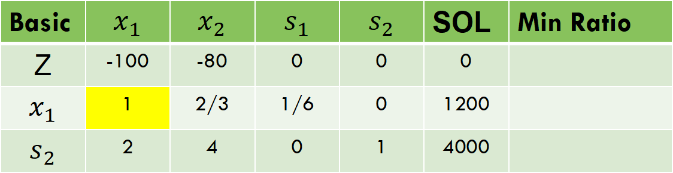

Simplex Method
By (1/6) $x_{1}$
Basic | $$x_{1}$$ | $$x_{2}$$ | $$s_{1}$$ | $$s_{2}$$ | SOL | Min Ratio
Z | -100 | -80 | 0 | 0 | 0
$$x_{1}$$ | 1 | 2/3 | 1/6 | 0 | 1200
$$s_{2}$$ | 2 | 4 | 0 | 1 | 4000
By z+(100) $x_{1}$ and $s_{2}$ -2 $x_{1}$
Basic | $$x_{1}$$ | $$x_{2}$$ | $$s_{1}$$ | $$s_{2}$$ | SOL | Min Ratio
Z | 0 | -40/3 | 50/3 | 0 | 120000
$$x_{1}$$ | 1 | 2/3 | 1/6 | 0 | 1200 | $$\frac{1200}{2/3}=1800$$
$$s_{2}$$ | 0 | 8/3 | -1/3 | 1 | 1600 | $$\frac{1600}{8/3}=600$$

Slide 8

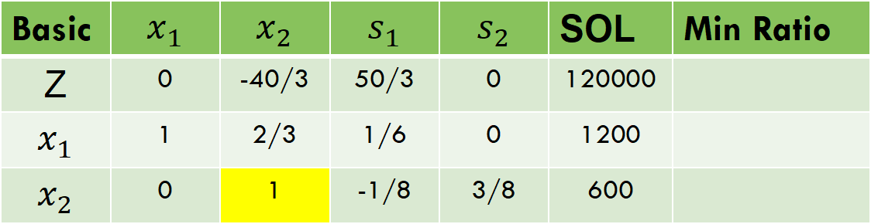
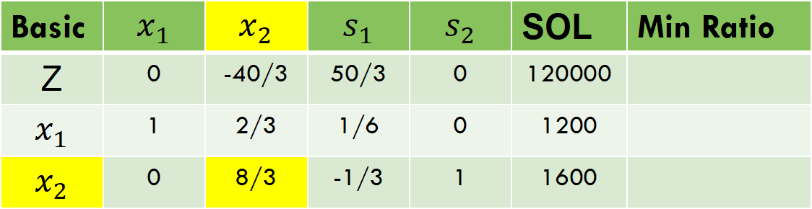
Simplex Method
Basic | $$x_{1}$$ | $$x_{2}$$ | $$s_{1}$$ | $$s_{2}$$ | SOL | Min Ratio
Z | 0 | -40/3 | 50/3 | 0 | 120000
$$x_{1}$$ | 1 | 2/3 | 1/6 | 0 | 1200
$$x_{2}$$ | 0 | 8/3 | -1/3 | 1 | 1600
By (3$/8)x_{2}$
Basic | $$x_{1}$$ | $$x_{2}$$ | $$s_{1}$$ | $$s_{2}$$ | SOL | Min Ratio
Z | 0 | -40/3 | 50/3 | 0 | 120000
$$x_{1}$$ | 1 | 2/3 | 1/6 | 0 | 1200
$$x_{2}$$ | 0 | 1 | -1/8 | 3/8 | 600

Slide 9

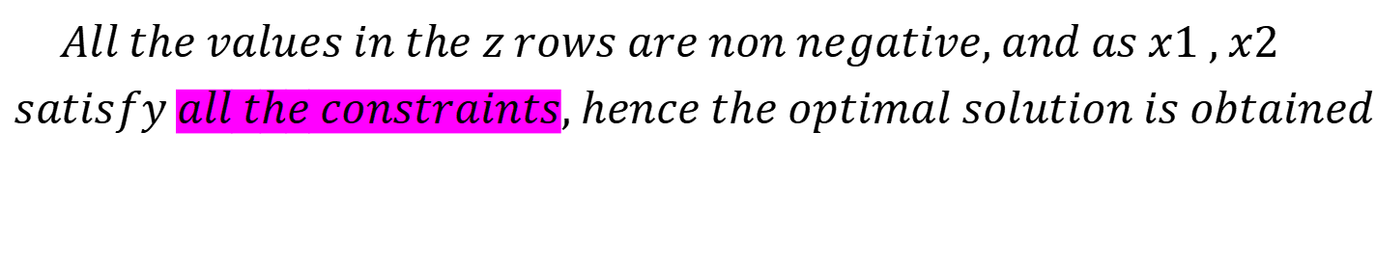
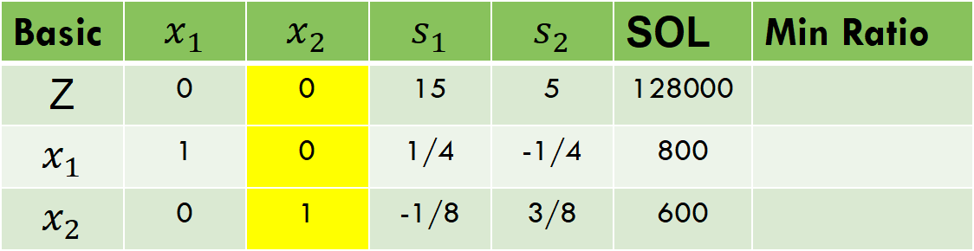

Simplex Method
By z+(40/3) $x_{2}$ and $x_{1}$ -(2/3) $x_{2}$
Basic | $$x_{1}$$ | $$x_{2}$$ | $$s_{1}$$ | $$s_{2}$$ | SOL | Min Ratio
Z | 0 | 0 | 15 | 5 | 128000
$$x_{1}$$ | 1 | 0 | 1/4 | -1/4 | 800
$$x_{2}$$ | 0 | 1 | -1/8 | 3/8 | 600
$$All the values in the z rows are non negative, and as x1 , x2$$
$$satisfy all the constraints, hence the optimal solution is obtained$$
$x_{1}=800$, $x_{2}=600, z=128000$

Slide 10
Unbounded Solution
if all values of key column are zero, then stop the procedure the solution is unbounded.

Slide 11
Simplex method
Example 2:
A and B are two products to be manufactured. Unit profits are 40 dollars and 35 dollars respectively. Maximum availability for product A is 60 and for B is 96. Each unit of A needs 2 Kg of material and 3 Man-Hours, Whereas each unit of B need 4 Kg of material and 3 Man-Hours. Find the Optimal Solution by using simplex method.

Slide 12

Simplex method
Products | Material | Man-Hours | Availability
A | 2 Kg | 3 | 60
B | 4 Kg | 3 | 96
oduct A to be manufactured
Max Z=40x1+35x2
Subject to Constraints:
$$2x_{1}+3x_{2}≤60$$
$$4x_{1}+3x_{2}≤96$$
$$x_{1},x_{2} ≥0$$

Slide 13
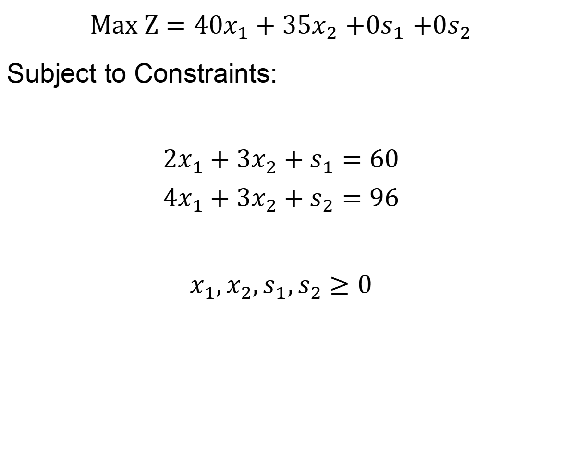
Simplex Method
$Max Z=40x_{1}+35x_{2}$ $+0s_{1}$ $+0s_{2}$
Subject to Constraints:
$$2x_{1}+3x_{2}+s_{1}=60$$
$$4x_{1}+3x_{2}+s_{2}=96$$
$$x_{1},x_{2},s_{1},s_{2}≥0$$

Slide 14
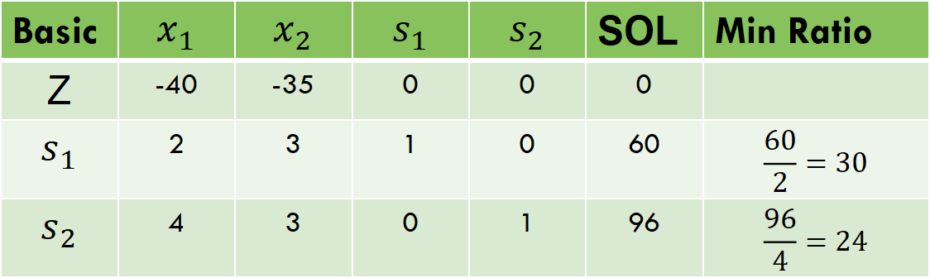

Simplex Method
$Z−40x_{1}−35x_{2}$ $−$ $0s_{1}−0s_{2}=0$
Basic | $$x_{1}$$ | $$x_{2}$$ | $$s_{1}$$ | $$s_{2}$$ | SOL | Min Ratio
Z | -40 | -35 | 0 | 0 | 0
$$s_{1}$$ | 2 | 3 | 1 | 0 | 60 | $$\frac{60}{2}=30$$
$$s_{2}$$ | 4 | 3 | 0 | 1 | 96 | $$\frac{96}{4}=24$$

Slide 15
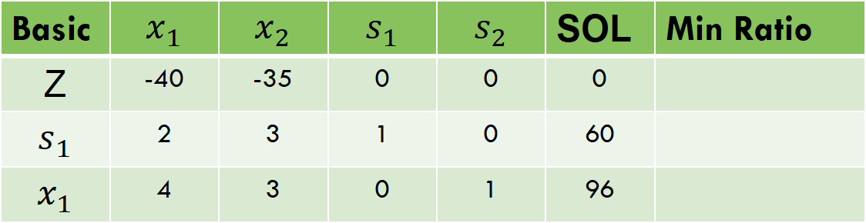
Simplex Method
Entering variable = Less negative value in z-row
Leaving variable= Minimum ratio value
Basic | $$x_{1}$$ | $$x_{2}$$ | $$s_{1}$$ | $$s_{2}$$ | SOL | Min Ratio
Z | -40 | -35 | 0 | 0 | 0
$$s_{1}$$ | 2 | 3 | 1 | 0 | 60
$$x_{1}$$ | 4 | 3 | 0 | 1 | 96

Slide 16
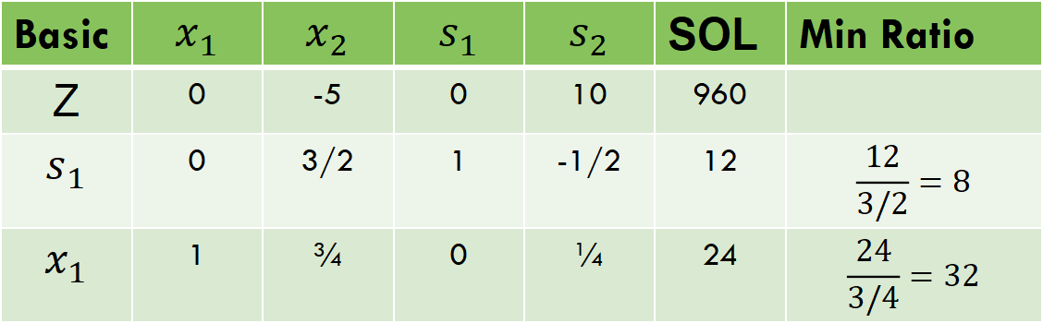



Simplex Method
By (1/4) $x_{1}$
Basic | $$x_{1}$$ | $$x_{2}$$ | $$s_{1}$$ | $$s_{2}$$ | SOL | Min Ratio
Z | -40 | -35 | 0 | 0 | 0
$$s_{1}$$ | 2 | 3 | 1 | 0 | 60
$$x_{1}$$ | 1 | 3/4 | 0 | 1/4 | 24
By z+(40) $x_{1}$ and $s_{1}$ -2 $x_{1}$
Basic | $$x_{1}$$ | $$x_{2}$$ | $$s_{1}$$ | $$s_{2}$$ | SOL | Min Ratio
Z | 0 | -5 | 0 | 10 | 960
$$s_{1}$$ | 0 | 3/2 | 1 | -1/2 | 12 | $$\frac{12}{3/2}=8$$
$$x_{1}$$ | 1 | ¾ | 0 | ¼ | 24 | $$\frac{24}{3/4}=32$$

Slide 17
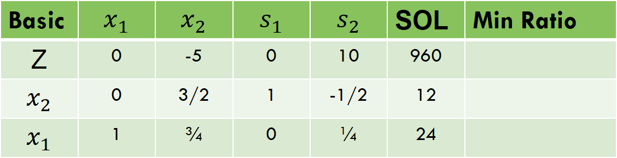

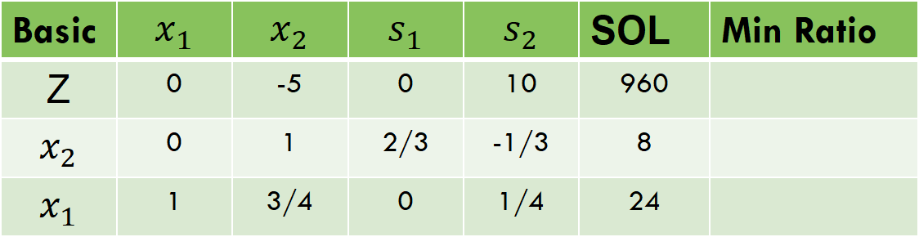
Simplex Method
Basic | $$x_{1}$$ | $$x_{2}$$ | $$s_{1}$$ | $$s_{2}$$ | SOL | Min Ratio
Z | 0 | -5 | 0 | 10 | 960
$$x_{2}$$ | 0 | 3/2 | 1 | -1/2 | 12
$$x_{1}$$ | 1 | ¾ | 0 | ¼ | 24
By (2$/3)x_{2}$
Basic | $$x_{1}$$ | $$x_{2}$$ | $$s_{1}$$ | $$s_{2}$$ | SOL | Min Ratio
Z | 0 | -5 | 0 | 10 | 960
$$x_{2}$$ | 0 | 1 | 2/3 | -1/3 | 8
$$x_{1}$$ | 1 | 3/4 | 0 | 1/4 | 24

Slide 18
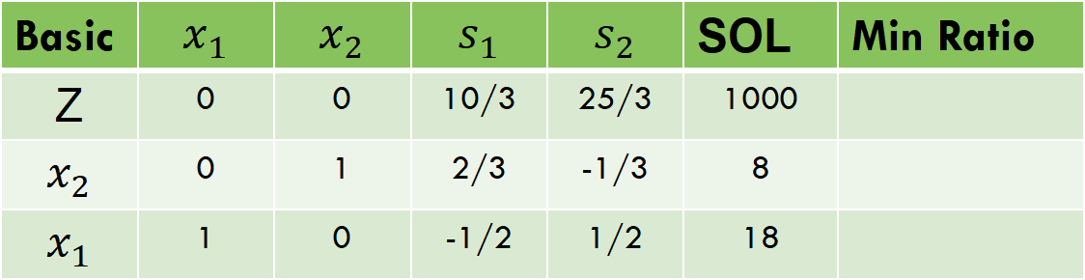

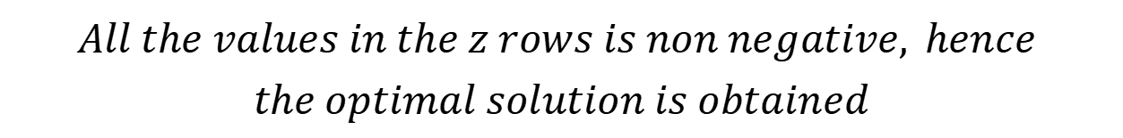

Simplex Method
By z+(5)$x_{2}$ and $x_{1}$ - (3/4) $x_{2}$
Basic | $$x_{1}$$ | $$x_{2}$$ | $$s_{1}$$ | $$s_{2}$$ | SOL | Min Ratio
Z | 0 | 0 | 10/3 | 25/3 | 1000
$$x_{2}$$ | 0 | 1 | 2/3 | -1/3 | 8
$$x_{1}$$ | 1 | 0 | -1/2 | 1/2 | 18
$$All the values in the z rows is non negative, hence$$
$$the optimal solution is obtained$$
$x_{1}=18$, $x_{2}=8, z=1000$

Slide 19
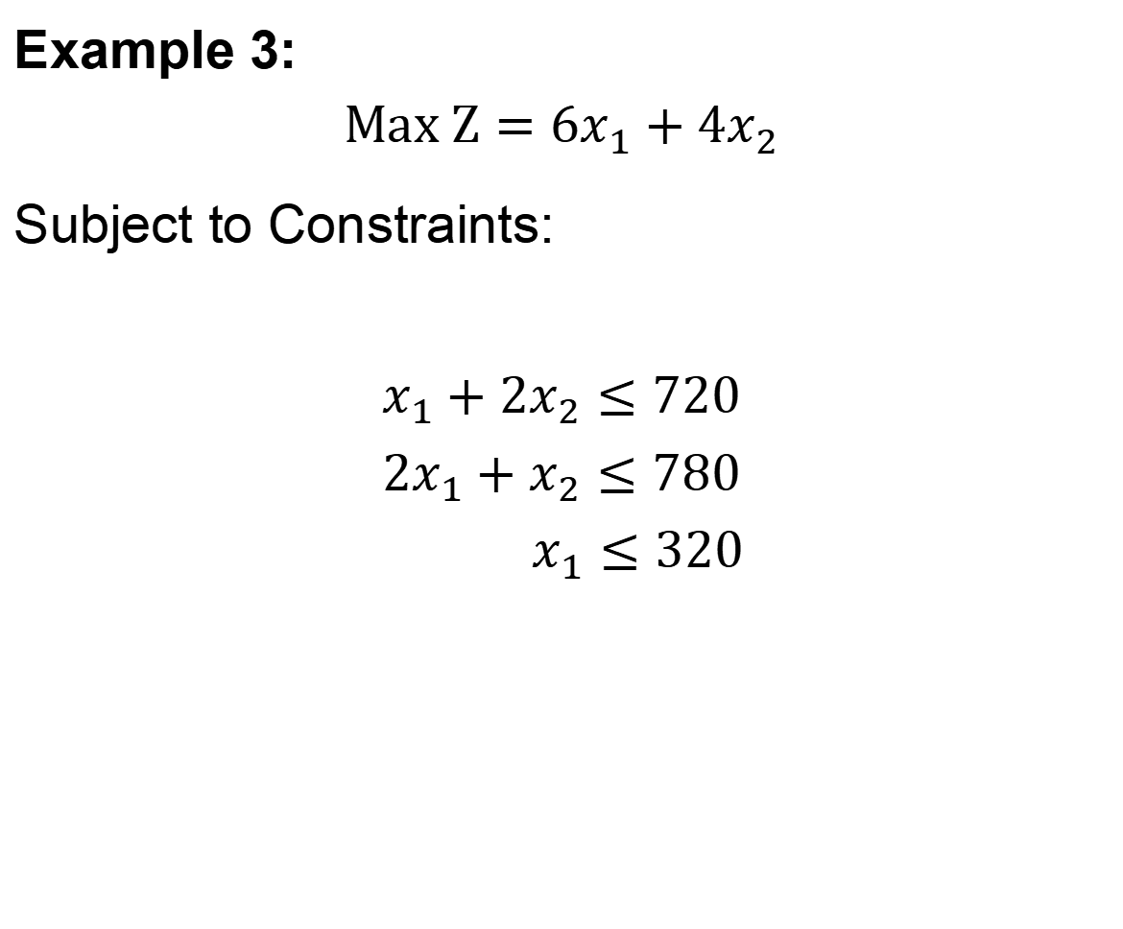
Simplex Method
Example 3:
$$Max Z=6x_{1}+4x_{2}$$
Subject to Constraints:
$$x_{1}+2x_{2}≤720$$
$$2x_{1}+x_{2}≤780$$
$$x_{1}≤320$$

Slide 20
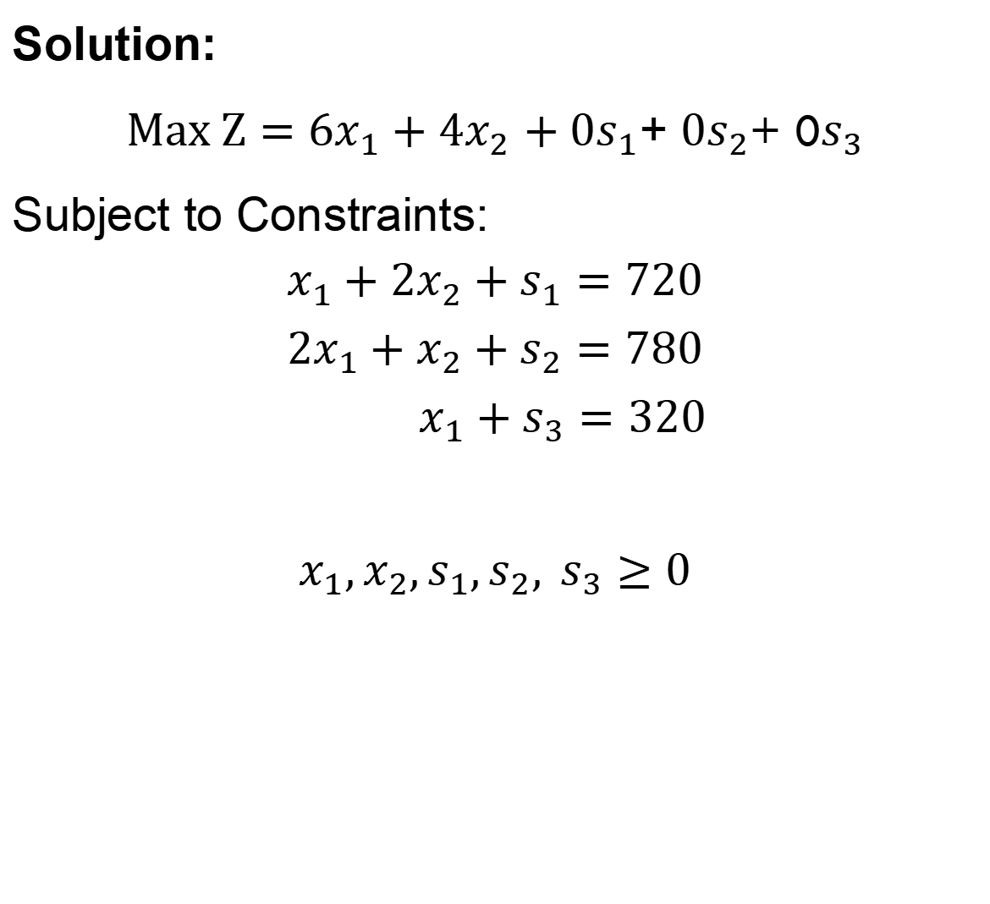
Simplex Method
Solution:
$Max Z=6x_{1}+4x_{2}$ $+{0s}_{1}$+ ${0s}_{2}$+ 0$s_{3}$
Subject to Constraints:
$$x_{1}+2x_{2}+s_{1}=720$$
$$2x_{1}+x_{2}+s_{2}=780$$
$$x_{1}+s_{3}=320$$
$$x_{1},x_{2},s_{1},s_{2}, s_{3}≥0$$

Slide 21
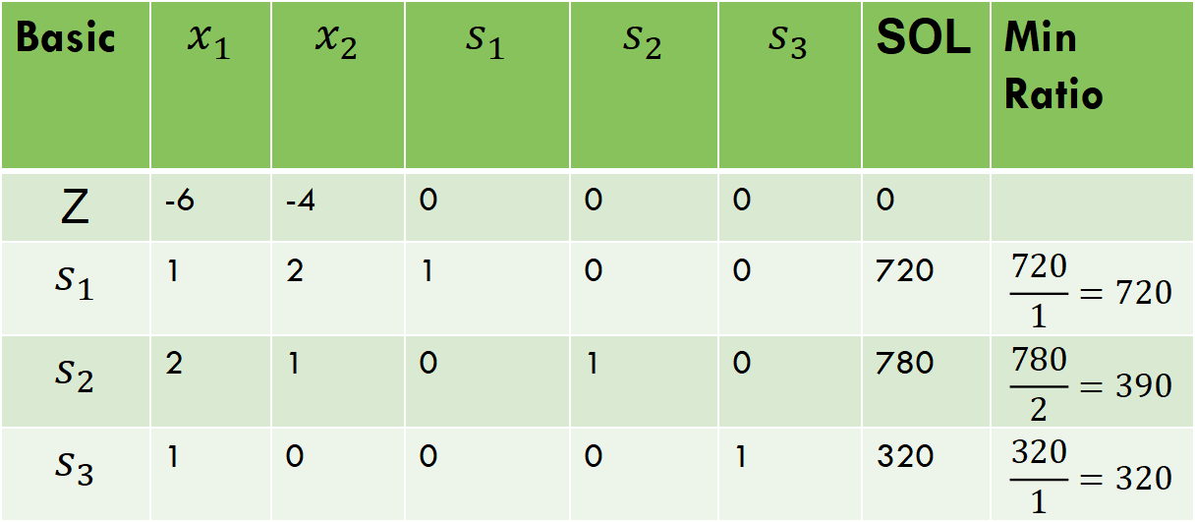

Simplex Method
$Z−6x_{1}−4x_{2}$ $−$ $0s_{1}−0s_{2}−0s_{3}=0$
Basic | $$x_{1}$$ | $$x_{2}$$ | $$s_{1}$$ | $$s_{2}$$ | $$s_{3}$$ | SOL | Min Ratio
Z | -6 | -4 | 0 | 0 | 0 | 0
$$s_{1}$$ | 1 | 2 | 1 | 0 | 0 | 720 | $$\frac{720}{1}=720$$
$$s_{2}$$ | 2 | 1 | 0 | 1 | 0 | 780 | $$\frac{780}{2}=390$$
$$s_{3}$$ | 1 | 0 | 0 | 0 | 1 | 320 | $$\frac{320}{1}=320$$

Slide 22


Simplex Method
Entering variable = Less negative value in z-row
Leaving variable= Minimum ratio value
$Z−6x_{1}−4x_{2}$ $−$ $0s_{1}−0s_{2}−0s_{3}=0$
Basic | $$x_{1}$$ | $$x_{2}$$ | $$s_{1}$$ | $$s_{2}$$ | $$s_{3}$$ | SOL | Min Ratio
Z | -6 | -4 | 0 | 0 | 0 | 0
$$s_{1}$$ | 1 | 2 | 1 | 0 | 0 | 720 | $$\frac{720}{1}=720$$
$$s_{2}$$ | 2 | 1 | 0 | 1 | 0 | 780 | $$\frac{780}{2}=390$$
$$x_{1}$$ | 1 | 0 | 0 | 0 | 1 | 320 | $$\frac{320}{1}=320$$

Slide 23
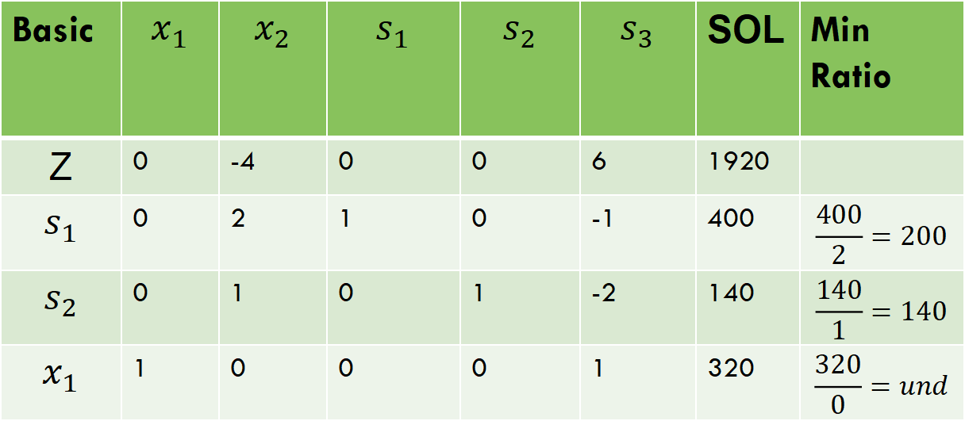
Simplex Method
By z+(6)$x_{1}$, ($s_{1}$ - $x_{1}) and{ (s}_{2}\text{ −} \text{2}x_{1})$
Basic | $$x_{1}$$ | $$x_{2}$$ | $$s_{1}$$ | $$s_{2}$$ | $$s_{3}$$ | SOL | Min Ratio
Z | 0 | -4 | 0 | 0 | 6 | 1920
$$s_{1}$$ | 0 | 2 | 1 | 0 | -1 | 400 | $$\frac{400}{2}=200$$
$$s_{2}$$ | 0 | 1 | 0 | 1 | -2 | 140 | $$\frac{140}{1}=140$$
$$x_{1}$$ | 1 | 0 | 0 | 0 | 1 | 320 | $$\frac{320}{0}=und$$

Slide 24
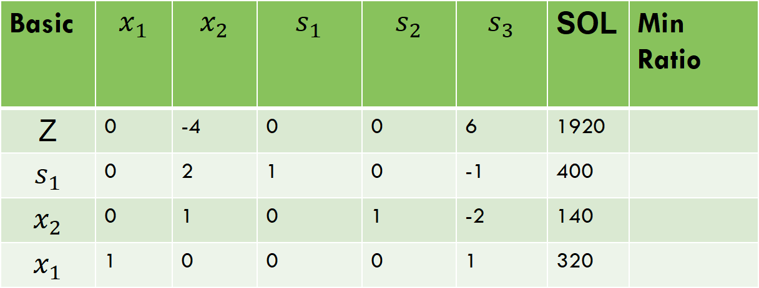
Simplex Method
Entering variable = Less negative value in z-row
Leaving variable= Minimum ratio value
Basic | $$x_{1}$$ | $$x_{2}$$ | $$s_{1}$$ | $$s_{2}$$ | $$s_{3}$$ | SOL | Min Ratio
Z | 0 | -4 | 0 | 0 | 6 | 1920
$$s_{1}$$ | 0 | 2 | 1 | 0 | -1 | 400
$$x_{2}$$ | 0 | 1 | 0 | 1 | -2 | 140
$$x_{1}$$ | 1 | 0 | 0 | 0 | 1 | 320

Slide 25
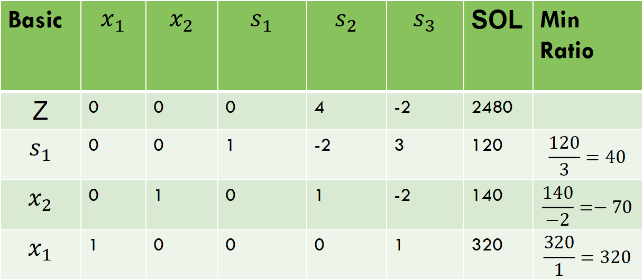
Simplex Method
By z+(4)$x_{2} and$ ($s_{1}$ - ${2x}_{2})$
Basic | $$x_{1}$$ | $$x_{2}$$ | $$s_{1}$$ | $$s_{2}$$ | $$s_{3}$$ | SOL | Min Ratio
Z | 0 | 0 | 0 | 4 | -2 | 2480
$$s_{1}$$ | 0 | 0 | 1 | -2 | 3 | 120 | $$\frac{120}{3}=40$$
$$x_{2}$$ | 0 | 1 | 0 | 1 | -2 | 140 | $$\frac{140}{−2}=−70$$
$$x_{1}$$ | 1 | 0 | 0 | 0 | 1 | 320 | $$\frac{320}{1}=320$$

Slide 26
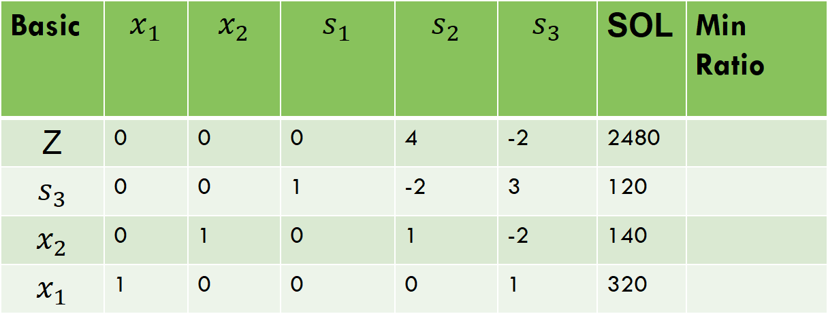
Simplex Method
Entering variable = Less negative value in z-row
Leaving variable= Minimum ratio value
Basic | $$x_{1}$$ | $$x_{2}$$ | $$s_{1}$$ | $$s_{2}$$ | $$s_{3}$$ | SOL | Min Ratio
Z | 0 | 0 | 0 | 4 | -2 | 2480
$$s_{3}$$ | 0 | 0 | 1 | -2 | 3 | 120
$$x_{2}$$ | 0 | 1 | 0 | 1 | -2 | 140
$$x_{1}$$ | 1 | 0 | 0 | 0 | 1 | 320

Slide 27
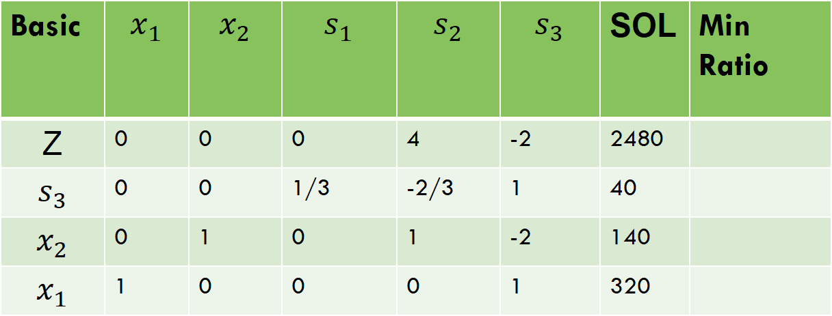
Simplex Method
By (1/3)$s_{3}$
Basic | $$x_{1}$$ | $$x_{2}$$ | $$s_{1}$$ | $$s_{2}$$ | $$s_{3}$$ | SOL | Min Ratio
Z | 0 | 0 | 0 | 4 | -2 | 2480
$$s_{3}$$ | 0 | 0 | 1/3 | -2/3 | 1 | 40
$$x_{2}$$ | 0 | 1 | 0 | 1 | -2 | 140
$$x_{1}$$ | 1 | 0 | 0 | 0 | 1 | 320

Slide 28

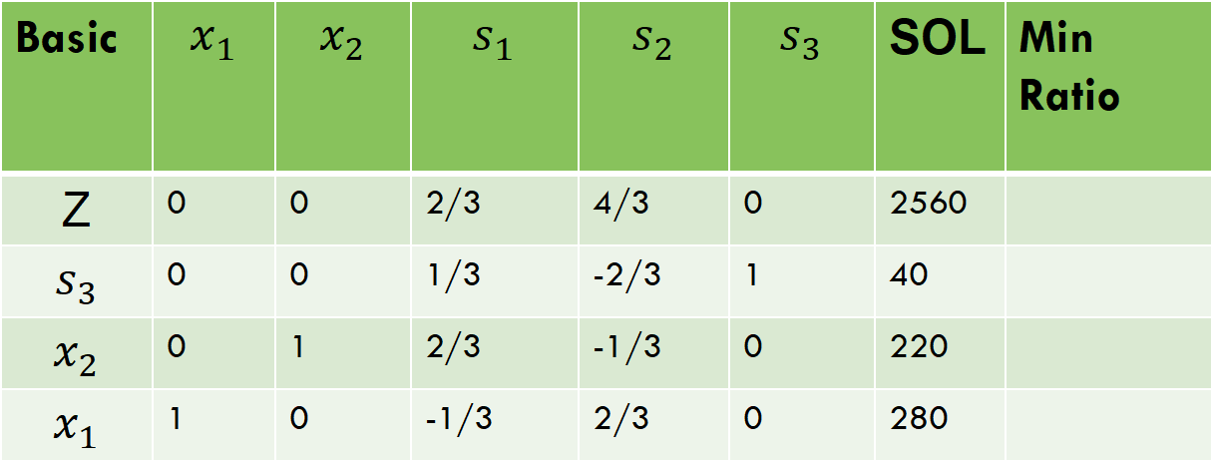
Simplex Method
By z +(2)$s_{3}, \left(x_{2}+2s_{3}\right) and{ (x}_{1}−s_{3})$
Basic | $$x_{1}$$ | $$x_{2}$$ | $$s_{1}$$ | $$s_{2}$$ | $$s_{3}$$ | SOL | Min Ratio
Z | 0 | 0 | 2/3 | 4/3 | 0 | 2560
$$s_{3}$$ | 0 | 0 | 1/3 | -2/3 | 1 | 40
$$x_{2}$$ | 0 | 1 | 2/3 | -1/3 | 0 | 220
$$x_{1}$$ | 1 | 0 | -1/3 | 2/3 | 0 | 280
$x_{1}=280$, $x_{2}=220, z=2560$

Slide 29
Thank you!

